Slide 1
EU Internal Market 2024-2025
Lectures 1-2: Introduction to the EU internal market and its structure
Andreas Georgiou
andreas.georgiou@durham.ac.uk

Slide 2
Student Voice Event – Voice Your Opinion!
The Law School wants to hear from you!
Your Highlights
Your Concerns
Your Ideas
16 October 2024, 2:00pm-3:30pm, Room TLC042

Slide 3
The structure of lectures 1-2
General information: the structure of this course
Introduction to the internal market
Building an internal market: positive and negative integration
The structure of free movement law

Slide 4
The structure of this course
There will be 20 lectures for this course (weekly on Fridays from 9-10am in E101): 10 lectures in Michaelmas Term and 10 lectures in Epiphany Term.
In Michaelmas Term, we will deal with three main topics: introduction to the internal market and its structure (2 lectures), free movement of goods (5 lectures) and EU citizenship (3 lectures).
Andreas will give the first 7 lectures; Pierre will deliver the remaining 13 lectures in the course. Tutorials are taught by Pierre.
Pierre is the module leader and his office is PCL194 (Thursdays, 12-2pm). Andreas can be found in PCL154 (Mondays, 11am-1pm). Please email in advance for an appointment.
There will be 5 tutorials (2 in Michaelmas Term, 2 in Epiphany Term and a revision tutorial in Easter Term)

Slide 5
The structure of this course
In Epiphany Term, we will cover the following topics: free movement of workers, free movement of establishment and free movement of services.
We will also regularly discuss the impact of Brexit and the new relationship between the UK and the EU.
We recommend Catherine Barnard’s The Substantive Law of the EU (OUP, 7th edition, 2022) as the main textbook for this course, but feel free to use other books that you might find useful. The textbook is available online on Oxford Law Trove (access through the Library website).
You will have to read the case law in detail. We will also regularly refer to relevant articles. You will see that free movement law is an area of EU law with a lot of strong opinions. Do read broadly to get a good feel for the various and different opinions!

Slide 6
The structure of this course
The course will be assessed by way of a summative essay (3,000 words, deadline to be confirmed (33% of your final mark) and a 3-hour written exam (67% of your final mark). You will have 24 hours to complete the exam online, which is open-book and take-home.
You will also have to submit a formative essay (2,000 words, deadline to be confirmed), which will give you a chance to practise your essay-writing skills.

Slide 7
Durham European Law Institute (“DELI”)
Series of lunchtime seminars on current EU law topics (2-3 events per term)
DELI also organises student-led events such as the Annual Debate, Internal Market Moot, EU Careers Event and a Dissertation Workshop
We are looking for student reps who are enthusiastic to be part of DELI, who will attend our events and help to organise student-led events
You can apply to be a DELI rep by completing the online form by Sunday 20th October: https://forms.office.com/e/M4sXvtjpFH

Slide 8
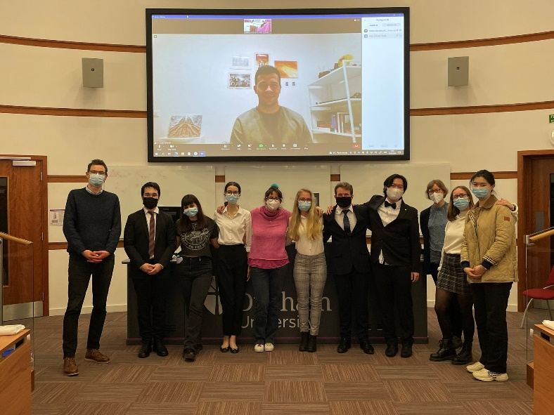
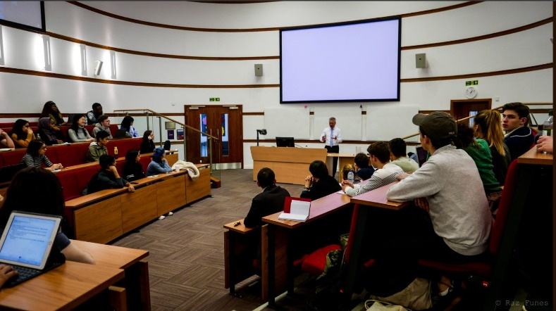
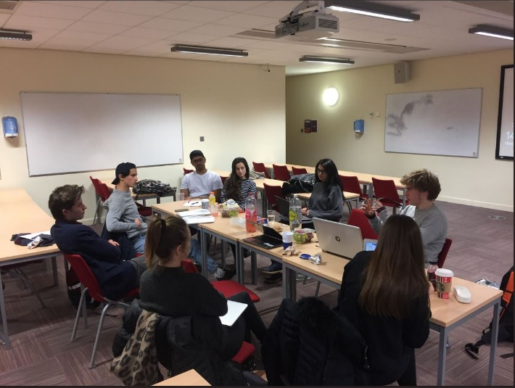

Durham European Law Institute (“DELI”)

Slide 9
What is an internal market?
What is a free trade area?
What is a customs union?
What is an internal market?
What is special about the EU internal market?
Brexit: the EU’s and UK’s perspective on the internal market

Slide 10
Why do we have an internal market in the EU?
The historical context: peace and well-being of EU citizens
The economic dimension of the internal market: economic efficiency
The social dimension of the internal market
The ethical dimension of the internal market

Slide 11


Slide 12
The development of the internal market
The substantive development of the internal market: from coal and steel to citizenship
The territorial development of the internal market: from 6 Member States to 27 Member States
The personal development of the internal market: from economically active citizens to pensioners and students

Slide 13
What are our rights in the internal market?
Free movement of goods (Article 34 TFEU)
Free movement of workers (Article 45 TFEU) and non-economically active citizens (Articles 20-21 TFEU and Directive 2004/38/EC)
Free movement of establishment (Article 49 TFEU)
Free movement of services (Article 56 TFEU and Services Directive 2006/123/EC)
Free movement of capital (Article 63 TFEU)

Slide 14
What are our rights in the internal market?
These free movement rights are not absolute: if Member States have a good reason (so-called “justifications”), they can restrict free movement between Member States
The grounds of justifications have been included in the Treaty (so-called “Treaty derogations”). Moreover, the Court of Justice has developed an additional catalogue of justifications in the case law (“mandatory requirements”, “objective justifications” or “public interest requirements”)

Slide 15
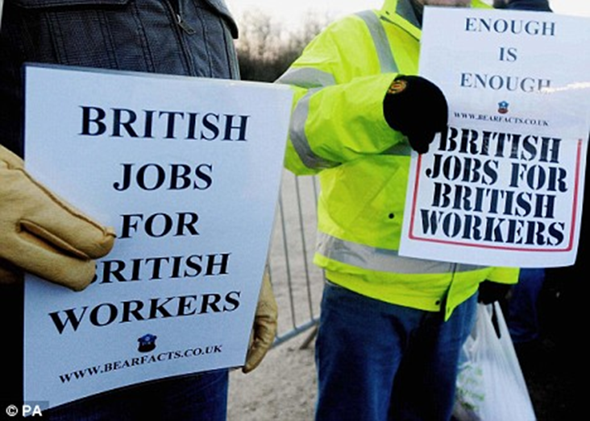
The internal market and Brexit
Can you explain whether, or to what extent, the slogan “British jobs for British workers” is compatible with being a member of the EU internal market?

Slide 16
How to build an internal market?
Negative integration: the Treaty provisions on free movement
    EU law tells the Member States what they cannot do through the prohibitions in the Treaty
    The focus is on national legislation which creates obstacles to free movement
    The main actors are individuals or companies who challenge national legislation under the free movement provisions (and the European Commission through the infringement procedure)
Positive integration (harmonisation): EU legislation
    National rules are replaced by uniform European standards
    The focus is on European rules which improve or facilitate free movement
    The main actor is the European legislature (Article 114 TFEU: link to EU Law last year)

Slide 17
The interaction between positive and negative integration
No harmonisation?: national rules are assessed under the Treaty provisions
Harmonisation?: national rules are assessed under the relevant secondary law
Examples of secondary law that we will look at in this course:
  The Citizen Rights Directive 2004/38/EC
  The Services Directive 2006/123/EC

Slide 18
The interaction between positive and negative integration
The intensity of the harmonisation: the difference between minimum and maximum (or full) harmonisation
With minimum harmonisation, the EU adopts the minimum standards. Member States are free to adopt higher standards above that minimum
If a Member State goes beyond the minimum standards provided in the secondary law, the national rules will be assessed under the Treaty provisions
With maximum harmonisation, the EU sets the absolute standard. Member States are not allowed to derogate from this standard. National rules are always assessed under the relevant secondary law

Slide 19
The interaction between positive and negative integration
The scope of the harmonisation: the difference between partial and exhaustive harmonisation.
With partial harmonisation, the EU has harmonised a certain part or aspect of a product or service. Member States are free to set their own additional rules on aspects which have not been regulated by the EU
These national rules are then assessed under the Treaty provisions
With exhaustive harmonisation, the EU has harmonised all aspects of a particular product or service. There is no more scope for Member States to adopt their own rules – everything has been regulated by the EU
As a result, national rules will then always be assessed under the relevant secondary law

Slide 20
The structure of free movement law
Most cases we will be looking at in this course are about negative integration: national rules are assessed under the Treaty provisions
For these cases, you will see that there is a certain structure in how the Court of Justice assesses free movement cases
You could see this structure as a sequence of steps. However, the Court does not necessarily address all steps of the structure
You will always have to start by analysing whether a case should be assessed under the free movement provisions or under secondary law

Slide 21
The structure of free movement law
The scope of the free movement provisions
Direct effect of the free movement provisions
A restriction of the free movement provisions
A ground of justification
Proportionality

Slide 22
The scope of the free movement provisions
The free movement provisions are only applicable if a case has a cross-border element or an inter-state dimension
If all the elements of a case are within one Member State, the free movement provisions are not applicable: this is a “wholly internal” situation
For most freedoms, the Court has held that the free movement provisions do not apply to national rules whose impact on cross-border trade is “too uncertain and indirect”
However, you will see that the Court is often flexible in finding a cross-border element – particularly in the case law on Union citizenship

Slide 23
Direct effect of the free movement provisions
All free movement provisions have vertical direct effect: private parties can rely on them against the State before national courts
It seems like most free movement provisions also have horizontal direct effect: private parties can rely on them against another private party
The only exception is the free movement of goods: the Court has always held that Article 34 TFEU does not have horizontal direct effect (but see Fra.bo)
The Court has held that Member States are under an obligation to facilitate free movement on their territory. This could mean that a Member State has to remove obstacles to free movement created by private parties (see Schmidberger and Commission v France (Spanish Strawberries))

Slide 24
A restriction of the free movement provisions
For each of the free movement provisions, you will see that the Court uses different methods to analyse whether there is a breach or restriction on free movement. The three most frequently used methods are:
Direct discrimination: the rule discriminates openly against nationals from another Member State. The discrimination is visible in the formulation of the rule (e.g. a nationality requirement)
Indirect discrimination: the discrimination is not visible in how the rule has been formulated, but the effect of the rule is to make it more difficult for non-nationals to comply with it (e.g. a language requirement)
Restriction/obstacle: even though the rule is genuinely non-discriminatory, it still makes it more difficult or less attractive for individuals to make use of their free movement rights (e.g. a requirement to take an exam)

Slide 25
The grounds of justification
Each free movement provisions has a corresponding list in the TFEU with grounds of justification Member States can rely on to justify a restriction of the free movement provisions: so-called Treaty derogations
In addition, the Court has also developed an open category of justifications in the case law. This is genuinely an open category: Member States can always rely on what they believe is a good reason to restrict free movement. Confusingly, they have been given different names for different freedoms: mandatory requirements, objective justifications, public interest requirements
The orthodox rule is that directly discriminatory rules can only be justified by Treaty derogations. All other rules can be justified by Treaty derogations and the case law-based justifications. However, note that the Court has recently become much more flexible about this (particularly for environmental protection)

Slide 26
Proportionality
Even if a Member State is able to rely on a ground of justification, it will still have to prove that the restriction is proportionate. Normally, the proportionality test involves two steps:
Suitability: is the measure suitable to achieve its aim? Make a connection between the tool chosen (the national rule) and the aim to be achieved (the ground of justification).
Necessity: is the measure necessary to achieve its aim? Does the Member State really have to go this far, or are there less restrictive measures which would still achieve the same aim?
Occasionally, the Court also uses a third step: the proportionality in the strict sense. In this final step, it analyses whether the right balance has been struck between the different interests involved (free movement vs. ground of justification). See C-302/86, Danish Bottles

